Slide 1
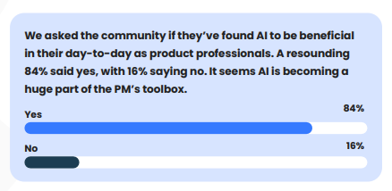
What do u think?

Slide 2

How to become an AI management pro
1. Customer-centric approach
2. Cross-functional collaboration
3. Agile and iterative development
4. Lifelong learning

Slide 3

Challenges
Lack of Knowledge in AI
Data quality and availability
Uncertainty and complexity
Regulatory compliance

Slide 4
key responsibilities in AI
1. Conduct market research:
2. Define product vision, roadmap, and prioritization:
3. Collaborate with stakeholders:

Slide 5
AI’s impact on the Leader’s life cycle
6 Phases

Slide 6
Iterate
Evaluate
Launch
Build
Validate
Discover

Slide 7
Making AI work
Define objectives
Data Preparation and Quality
Choose the right algo
Training and Test
Deployment
Monitoring and Iterate

Slide 8
Automating repetitive task in Product Management
Data Collection
PM software
Customer Support and feedback
Automated reports
Email
Customer Onboarding

Slide 9
How to handle?
Education and Awareness
Ethics By Design
Diverse and Inclusive Teams
Risk Assessment
Transparency and Accountability
Data Governance
Collaboration with Stakeholders
Continuous Monitoring and Iteration

